Slide 1
HCI 440: Week 1
Getting Started with UCD

Slide 2

INTRODUCING MYSELF
HI! I’m Danyell Jones!
UX Researcher at Facebook
MS in HCI from DePaul University
Avid Cat Lover
Dog Mom
Very Slow Runner

Slide 3
NOW, INTRODUCE YOURSELF
Tell us your first name (that you want to be called) and last name
What you do (job or school or both)
Degree you're seeking and how far along
By next class, please enter all this information about yourself on the Introductions discussion forum on D2L (start a new thread for yourself)
Worth one (1) participation point

Slide 4
COURSE SUMMARY
This course focuses on the principles, practices, and techniques of performing user-centered interaction design (UCID), including:
User research using contextual inquiry (observations and insights);
User requirements and design-informing models (personas, concept maps, user journey maps);
Conceptual design (conceptual task scenarios, site map, wireframes);
Prototyping (low-fidelity prototype);
Evaluation (evaluating design with real users)
The course provides you with both a basic kit of tools and techniques, as well as a process framework in which to use these
This separation is important because tools and techniques and processes evolve and change (somewhat) independently of the others

Slide 5
Learning Objectives
Students will demonstrate understanding of the vocabulary, principles, practices, and disciplines involved in user-center interaction design and its areas of application in a series of team assignments and quizzes. (LO1)
Students will implement the essential elements of the user-centered design process in a series of team assignments. (LO2)
Students will apply research methods such as competitive analysis, user observation, and user interviews to establish interaction design requirements for team assignments. (LO3)
Students will apply the principles of user-centered interaction design to create coherent interaction designs that implement requirements and reflect design and usability principles. (LO4)
Students will apply iterative design and prototype evaluation methods to refine their interaction designs in successive team assignments. (LO5)
Students will communicate the results of their work in an effective and professional manner through written reports and recorded video presentations. (LO6)
Students will apply effective interpersonal skills in order to participate and contribute to the efforts of a multidisciplinary team. (LO7)

Slide 6
ADMINISTRATIVE INFO
The syllabus contains all the essential course logistics information, especially for course policies and procedures
Read it and refer to it before asking procedural or logistical questions
If you ask me a question that is answered in the syllabus or in this module, I will simply point you to the appropriate source
The course meets each week for a total of ten (10) classes
There is no Week 11 in Summer Quarter

Slide 7
CLASS SESSIONS
Basic class structure is: lecture, discussions, and a short activity
On weeks when an assignment is due (on that Monday), at least one hour of class is devoted to an assignment ‘workshop
Bring your the work you’ve done with you to class
I’ll spend time answering questions individually, in groups, or in general
For team assignments, it’s best if all in-class team members attend class
Async students may come to class if available at the time- otherwise lectures are posted after class
Post questions beforehand on D2L’s Q&A and Support forum, or post questions through Online Rooms

Slide 8
There are no prerequisites for the course, but that doesn’t mean everyone is starting from the same point—students have a wide range of backgrounds and expertise

Slide 9
Prerequisites
Good cop version:
For those with experience in UCID: please be understanding and supportive of those new to the field, and respectful of their opinions
For those new to UCID: if you have a grounded opinion, don’t be afraid to assert it in opposition to a more-experienced team member
Bad cop version:
If a team reports dominance problems, I will investigate and confirm the problem, then give the dominance offender one warning
The second confirmed report means I will remove the offender from the team
Removal means that you will need to complete all the rest of the team coursework on your own, at only 80% credit

Slide 10
ASSIGNMENT INFORMATION
Introductions posting—counts as 1 spare participation point
Weekly participation postings—must be substantive
Participation forums close 1 week + 1 day after class—no extensions
Academic Integrity Quiz—must be done before you can submit (individual) Assignment 1—counts as 1 spare participation point
Individual assignment—your idea for the series of team assignments
Research participation - 2 required studies, 4 points each
Team assignments—encompass essentials of UCID process
Time allowance for assignments: 10 days
Three online quizzes during quarter—quizzes are available online for a minimum of 3 days—extensions only for exceptional situations

Slide 11
ANOTHER SPARE PARTICIPATION POINTS OPPORTUNITY
The CDM Participant Pool is for faculty and student involvement in research studies (IRB approved) and classroom–based research (no IRB needed)
Students in the Chicago area and who can get to the DePaul campus—both in-class and OL—can earn up to two (2) spare participation points:
Sign up as a participant at: http://www.cdm.depaul.edu/academics/research/Pages/Instructions-for-Participants.aspx
Complete the pre-screener to see if you qualify as a participant
If you qualify, earn 1.0 point for each 30 minutes of involvement in any of the studies
I will apply the participation credit around Week 10 or later

Slide 12
Team peer reviews
At the completion of each team assignment, students must complete an online peer review of each of their teammates
Review covers initiative, reliability, amount and quality of work, and support of learning
Reviews are delivered using the D2L Quiz tool
The review is used, if necessary, to adjust a student’s grade on the assignment, and in determining each student's final team assignment participation grade component
An average score of 15/25 or above has no impact on student’s grade
An average score below 15/25 has up to a 30% impact on grade
All average scores below 15/25 are confirmed with team members
The affected student is notified of the average score and its impact on the grade
Other students NEVER have access to the score that you give to them

Slide 13
TEXTBOOK
One text is required:
Hartson, R. and P.S. Pyla (2012). The UX Book: Process and Guidelines for Ensuring a Quality User Experience, Morgan Kaufmann/Elsevier Science, 2012.
ISBN: 978-0123852410
This is also available online at the DePaul Libraries Web site: http://library.depaul.edu/ in the Safari database
Note: There is a DePaul-wide seven-user limit on Safari
I do not follow the text 100%- no one text is comprehensive, so I draw on a number of additional sources for the course content

Slide 14
COURSEWORK PROPORTIONS
Coursework | Grade Proportion
Participation | 20 points
Individual assignment | 40 points
Team assignments | 420 points
Team participation | 125 points
Quizzes | 223 points
Total | 828 points

Slide 15
Learning Management System
We use Desire2Learn (hereafter: D2L), accessed at: https://d2l.depaul.edu/
D2L holds most course content except Course Online (COL) recordings and any screencasts
Access to COL recordings is available from the course homepage widget in D2L
If needed, screencasts are downloadable MP4 files
Note : If you have technical problems with D2L—such as the site being down or being unable to log in—please contact D2L support; I have control over only the course site content

Slide 16
SUPPORT
I will answer emails within 24 hours
All routine notifications will be posted under News on the course homepage
You should subscribe to ‘News - new item available’ and ‘News - item updated’ to ensure you stay on top of all course notices and announcements
Technical questions may be addressed during office hours or via the D2L Q&A and Support Forum
Outside office hours, use the D2L Q&A and Support Forum for logistical and technical questions
Provide appropriate support to each other
You should subscribe to the Q&A and Support Forum to receive email notifications when questions and answers are posted

Slide 17
Support
Contact me by e-mail for personal issues only—DO NOT use email for non-personal technical or logistical questions
Please include your name, course number, and whether in-class or OL in all correspondence
Example: Charlie Darwin (HCI 440 OL)
Email that does not contain this information will be returned with only a ‘new phone, who is this?’ in the body of the text, even if I recognize your name
All email and forum communication should follow proper informal business correspondence etiquette. This means:
It must use proper informal business English
It must be civil and professional
It must provide enough information for the issue to be addressed immediately: please review carefully before you hit ‘Send’ or ‘Post’

Slide 18
Intellectual property issues
All original material in this course is property of the instructor
You are permitted to download and print copies of the material for your own use
You are not permitted to redistribute the material in any form
This is a zero-tolerance course with respect to Academic Integrity violations
Plagiarism is to take and use as one’s own, or copy without acknowledgement, the works of another person
Cheating encompasses both inappropriate use of another person’s work and facilitating that use
Every student must complete an academic integrity awareness quiz before being able to submit the first assignment

Slide 19
“You don’t think about your toothbrush being designed until you put a bad toothbrush in your mouth.”
– Paul Bernett, Design Consultant
in The Genius of Design (video)

Slide 20
Bad design
A bad design has one or more of the following characteristics:
It is infuriating or annoying to use
It is confusing, baffling, or puzzling to use
It is inefficient to use, requiring a large number of steps to accomplish simple tasks
It is difficult to use, needing much effort or skill to use or understand
It demands that you serve the design, rather than the design serving you
It is not obvious how to use the design to accomplish required tasks
In other words, in some way, a bad design is unpleasant, painful, or even disruptive to use
Note that some of these may be strongly coupled; e.g., being not obvious could lead to the design being puzzling

Slide 21
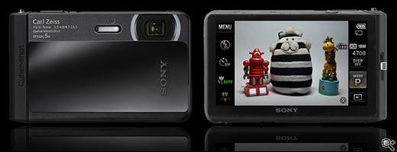
Bad design example: Sony TX-30
The Sony TX-30 is a compact, ruggedized pocket digital camera
Virtually all functions are accessed via the touchscreen interface
It is waterproof to 10m underwater
It uses a capacitive touchscreen interface which is unusable when wet
It demands that you serve the design, rather than the design serving you
Image © www.dpreview.com

Slide 22
Good design
A good design has one or more of the following characteristics:
It uses familiar objects or metaphors
It is aesthetically pleasing and enjoyable to use
It requires a minimum number of steps to accomplish basic tasks
It has a simple and elegant design
It provides just the right amount of functionality
It can be used by anyone with minimal orientation
Again, note that some of these may be strongly coupled; e.g., being simple may require minimal orientation
In other words, in some sense, a good design is pleasurable to use

Slide 23

Good design example: Lumix TS5
The Panasonic Lumix TS5 is another compact, ruggedized pocket digital camera
All functions are accessed via buttons and a 4-way selector
It is waterproof to 13m underwater
All functionality is available when wet or submerged
Image © www.dpreview.com

Slide 24
Lesson: understand the context of product use
Who is going to be using the product?
How is the product going to be used?
Where are people going to be using the product?
What kinds of activities are people doing when interacting with the product?
Appropriateness of an interface depends on what kinds of activities the product supports and the context of those activities
The Lumix TS5 was designed to purpose—the Sony TX-30 was adapted to purpose

Slide 25
What is Interaction Design (IxD)?
Interaction design (IxD) means “designing interactive products to support the way people communicate and interact in their everyday and working lives”*
Further: “It is about creating user experiences that enhance and augment the way people work, communicate, and interact”*
Interaction design encompasses:
User interface design
Software design
User-centered design
Product design
Web design
Experience design
Interactive system design
* From Interaction Design: Beyond Human-Computer Interaction by Y. Rogers, H. Sharp, and J. Preece, Wiley, 2011

Slide 26
Choices, choices
What do you do using computer- or digitally-assisted systems?
Examples: Create class presentations; send/respond to email; send text messages; wash and dry clothes
How do users can interact with these systems?
Examples: Menus; commands; gestures; conventional physical movements; or, a mix of one or more of these
What do you use to interact with these systems?
Examples: Physical keyboards; touch screen; hybrid pointing and touch surface devices (e.g., Apple’s Magic Mouse); pen stylus; physical buttons and dials; voice/audio (e.g., Siri)

Slide 27
Guiding question—and some possible answers
Question:
How do you facilitate a users’ interactions with a product so that the interactions both support and extend the users’ activities in effective and usable ways?
Some answers:
Account for what people are good and bad at doing
Consider what might help people with the way they currently do things
Think through what might provide quality user experiences
Listen to what people want and involve them in the design
Use tried-and-tested user-based techniques in the design process

Slide 28
Who is involved in interaction design?
Practically, no one person embodies in-depth knowledge in all interaction design disciplines
So, interaction design mostly is done in multidisciplinary teams

Slide 29
Who is involved in interaction design?
Some roles include:
Engineers
Designers
Programmers
Psychologists
Anthropologists
Sociologists
Artists
Modelers & others
The composition of a team depends on an organization’s design philosophy, size, purpose, and product line, as well as the product’s budget and its role in the company’s business

Slide 30
Interaction Design professionals
Interaction designers. Involved in the design of all interactive aspects of a product
Usability engineers. Focus on evaluating products, using usability principles and methods
Techniques are quantitative, based on measuring user activity
Web designers. Develop and create the visual design of websites
Information architects. Plan and structure information organization and navigation in interactive products
Information architects increasingly work closely with content managers, who collect, edit, prioritize, and publish information
May also carry out field studies to inform the design of products
User experience designers (UX). Do all of the above, but employ both quantitative and qualitative techniques

Slide 31
User experience is one of the central concepts in interaction design
The user experience:
Is how people feel about a product
Is the pleasure and satisfaction they experience when using it, looking at it, holding it, or simply opening and closing it
Includes their overall impression of how good it is to use the product
Includes the smallest details
Experiences may be:
Quick/Short Duration: Using a gas pump interface
Leisurely: Playing a computer game
Integrated/Holistic: Using interactive media for a museum visit: before, during, and after

Slide 32
User Experience
You cannot design a user experience, only design for a user experience
Implication: The design may be successful or unsuccessful

Slide 33
User Experience
Product characteristics important to user experience include:
Usability
Functionality
Aesthetics
Content
Look and feel
Sensual appeal
Emotional appeal
User characteristics—user demographics—important to user experience include:
Social capital (identity)
Age
Ethnicity
Income
Occupation
Education
Expectations

Slide 34
Scenarios
A scenario is a narrative prose description of human tasks, needs, or activities
In an agile environment, referred to as a user story
It describes the use of artifacts—it does not explicitly describe the use of artifact technology in detail
It uses the vocabulary of the stakeholders to make it accessible
A stakeholder is anyone who has an interest or concern in the product, application, or service in question
A scenario might be used to introduce subjects or stakeholders to the problem area or product idea
The scenario gives them a context in which to provide you with requirements data

Slide 35
Scenario example: Evernote
On Friday afternoon, your boss tells you that next Monday, you’ll need to be in Green Bay, Wisconsin, to provide some on-site support for one of your customers.
You decide to drive up from Chicago on the preceding Saturday and do some sightseeing. You search Yelp and Google for ‘Green Bay, Wisconsin’ and find a number of sights and restaurants of interest in the area. You clip the information for each to Evernote.
On Saturday, at a rest stop close to Green Bay, you use your mobile to access Evernote and then visit a few saved sights before checking into the hotel. Once settled at the hotel, you use Evernote to select an interesting restaurant for dinner.

Slide 36
Describing Interaction in Images: Sketches
Sketching is an essential interaction designer’s tool
Sketching helps express, develop, and communicate ideas—it’s a way of thinking and problem-solving
In fact, sketching is thinking and problem-solving
Sketching helps with getting the design right and getting the right design
In other words, it helps us address the right problem and develop a good solution to that problem
Sketching is a critical part of the process of:
Idea generation
Design elaboration
Making design choices
Development

Slide 37
Sketch Characteristics
Quick | Making them does not require long periods of time.
Timely | You can create sketches on demand.
Inexpensive | Creating them is cheap, using materials you have on hand.
Disposable | You don’t care if sketches get thrown away.
Plentiful | Sketches don’t exist in isolation from one another.
Clear and use a common vocabulary | Sketches comprise simple symbols and lines.
Fluid | They have a fluidity of line and flow that imply creativity.
Minimally detailed | Sketches are conceptual and suggest structure.
Appropriately refined | They communicate just enough so others can understand your intent.
Suggestive and exploratory rather than confirming | When sketching, you haven’t yet made any concrete decisions.
Ambiguous | You have yet to work out the details, then overlay your design on the foundation your sketches provide.
From: http://www.uxmatters.com/mt/archives/2010/05/sketches-and-wireframes-and-prototypes-oh-my-creating-your-own-magical-wizard-experience.php#sthash.2EXmMZTf.dpuf

Slide 38
Notational sketching
Notational sketches are used to record observations and ideas
Do them quickly to keep pace with your thinking
Keep them loose. Drawing too slowly becomes a conscious act and hinders the flow of thought
Think of what would happen if you became conscious of forming each letter of your handwriting
Keep them roughly rough. Shun meticulous (unnecessary) detail
Get your ideas down on paper quickly
Rough does not mean sloppy or inaccurate
Messy is OK. But not so messy that clarity is compromised
Sketches are the first rough drafts of personal thought created to capture an observation or idea
“Embrace the occasional wonky cube, hairy drawing, or erring wavy line; they are minor blemishes in the scope of a much larger process”
Text adapted from: Drawing Ideas: A Hand-Drawn Approach for Better Design by M. Baskinger and W. Bardel, Watson-Guptill, 2013

Slide 39
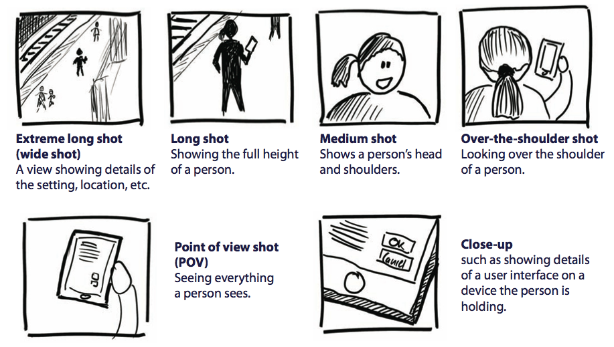
Useful notational sketches for IxD: camera shots
Image from Sketching User Experiences: The Workbook by S. Greenberg, S. Carpendale, N. Marquardt, and B. Buxton, MK-Elsevier, 2012

Slide 40
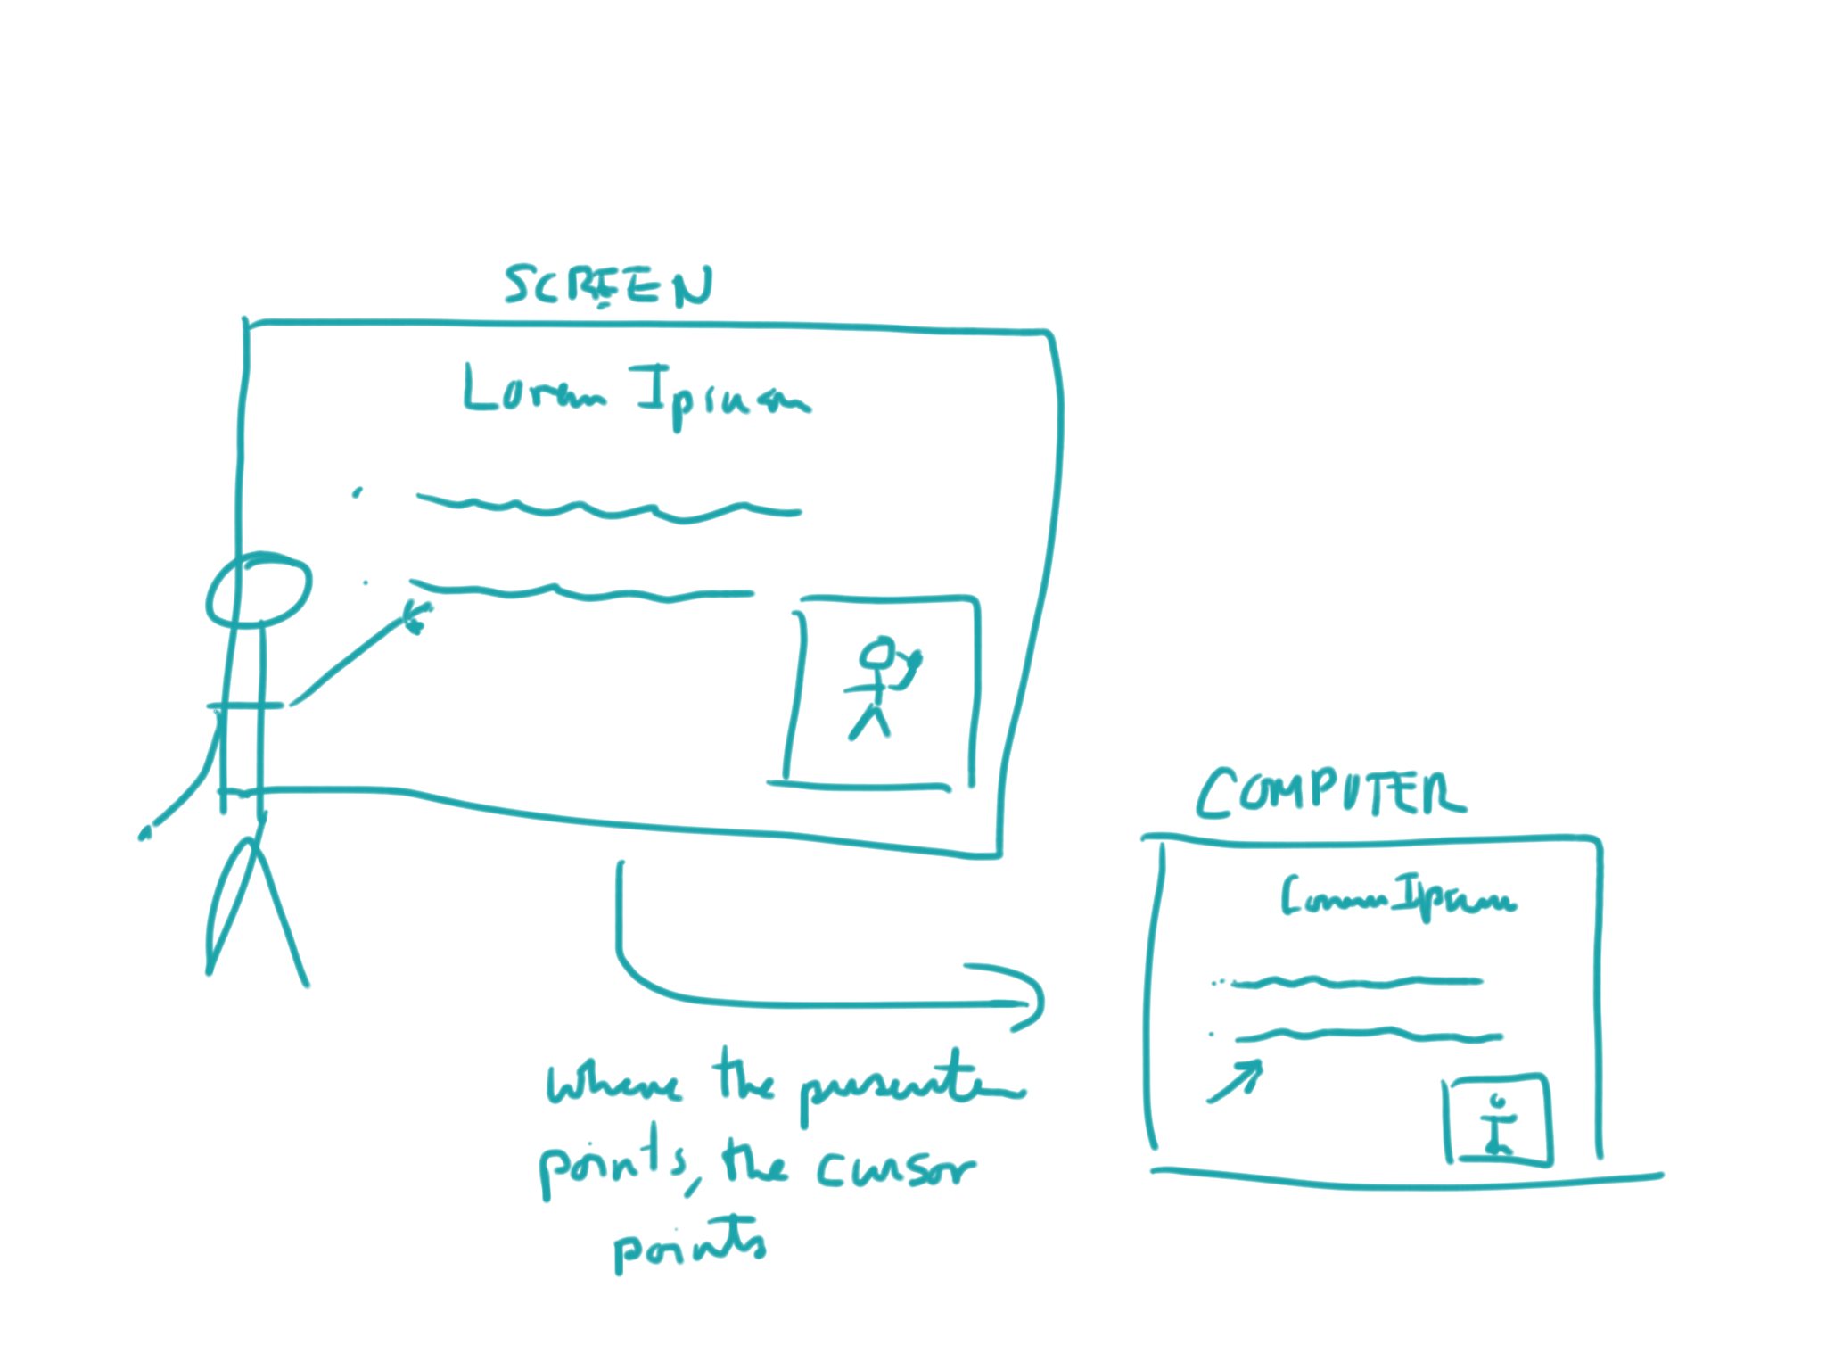
A sketch for a whiteboard pointer idea
Pointer in use. As the user points while holding the pointing device, the cursor on the instructor workstation points to the same location on the slide.
Long shot
Close-up

Slide 41
Affordances
The relevant part of what the dictionary says about “to afford” is that it means to offer, yield, provide, give, or furnish.
For example, a study window in a house may afford a fine view of the outdoors; the window helps one see that nice view.
In HCI design, where we focus on helping the user, an affordance is something that helps a user do something.
In interaction design, affordances are characteristics of user interface objects and interaction design features that help users perform tasks.

Slide 42
Four Types of Affordances
Affordance Type | Description | Example
Cognitive affordance | Design feature that helps users in knowing something | A button label that helps users know what will happen if they click on it
Physical affordance | Design feature that helps users in doing a physical action in the interface | A button that is large enough so that users can click on it accurately
Sensory affordance | Design feature that helps users sense something (especially cognitive affordances and physical affordances) | A label font size large enough to be discerned
Functional affordance | Design feature that helps users accomplish work (i.e., usefulness of a system function) | The internal system ability to sort a series of numbers (invoked by users clicking on the Sort button)

